Slide 1
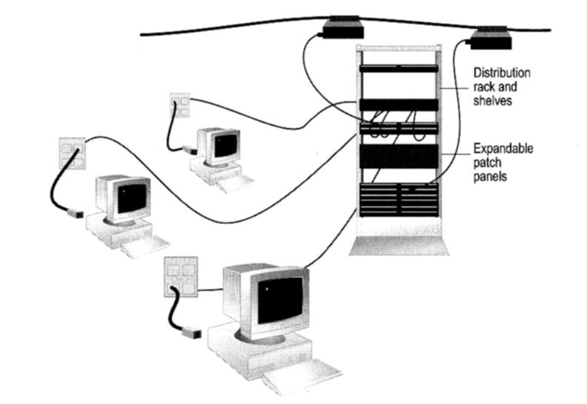
Ethernet A Case study of Physical and Data Link Layer

Slide 2
Origin of Ethernet
Basis for the IEEE’s 802.3 specification Ethernet: It is a LAN protocol that is used in Bus and Star topologies and implements CSMA/CD as the medium access method
Found by Xerox Palo Alto Research Center (PARC) in 1975
Original designed as a 2.94 Mbps system to connect 100 computers on a 1 km cable
Ethernet developed in 1980 by three companies: Digital, Intel, Xerox (DIX) drew up a standard support 10 Mbps.
In 1985, the Computer Society of the IEEE started a project, called Project 802, to set standards to enable intercommunication among equipment from a variety of manufacturers.
Current version is called IEEE Ethernet

Slide 3
Ethernet Basics
Topologies Linear bus, Star bus
Signaling Mainly baseband (digital)
Access method CSMA/CD
Specifications IEEE 802.3
Transfer speed 10 Mbps, 100 Mbps, 1Gbps
Cable types Coaxial cables, UTP

Slide 4
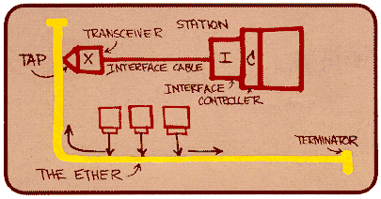
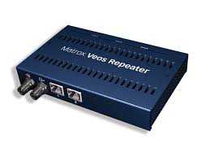
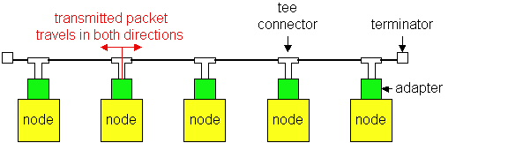
Ethernet Standard Defines Physical Layer
802.3 standard defines both MAC and physical layer details
Metcalfe’s original
Ethernet Sketch

Slide 5
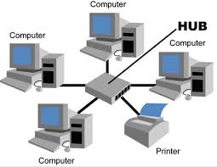
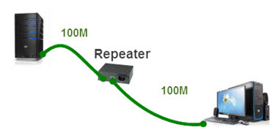
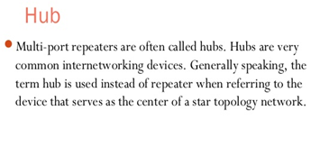
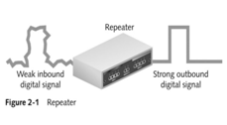
Repeaters used to connect multiple segments
Repeater repeats bits it hears on one interface to its other interfaces: physical layer device only!

Slide 6
IEEE Ethernet
In IEEE 802.3 Ethernet Data link layer is split into two sublayers:
Bottom part: MAC
The frame is called IEEE 802.3
Handles framing, MAC addressing, Medium Access control
Specific implementation for each LAN protocol
Defines CSMA/CD as the access method for Ethernet LANs and Token passing method for Token Ring.
Implemented in hardware
Top part: LLC (Logical Link Control)
The subframe is called IEEE 802.2
Provides error and flow control if needed
It makes the MAC sublayer transparent
Allows interconnectivity between different LANs data link layers
Used to multiplex multiple network layer protocols in the data link layer frame
Implemented in software

Slide 7
Ethernet Provides Unreliable, connectionless Service
Ethernet data link layer protocol provides connectionless service to the network layer
No handshaking between sending and receiving adapter.
Ethernet protocol provides Unreliable service to the network layer :
Receiving adapter doesn’t send ACK or NAK to sending adapter
This means stream of datagrams passed to network layer can have gaps (missing data)
Gaps will be filled if application is using reliable transport layer protocol
Otherwise, application will see the gaps

Slide 8
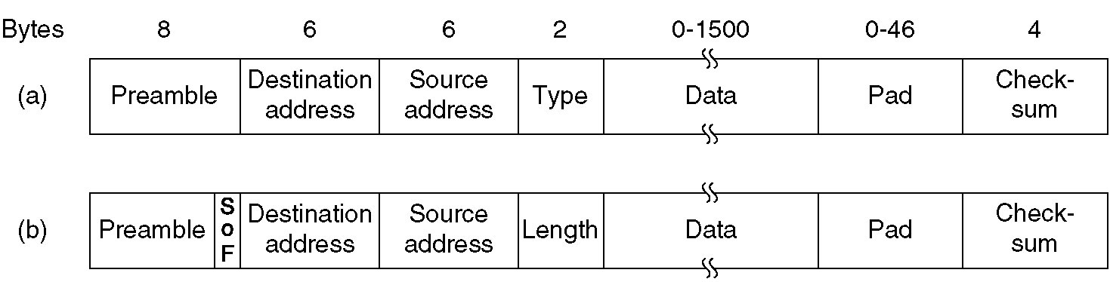
Ethernet
Ethernet Frame format
FCS
FCS
Frame formats. (a) DIX Ethernet , (b) IEEE 802.3.

Slide 9
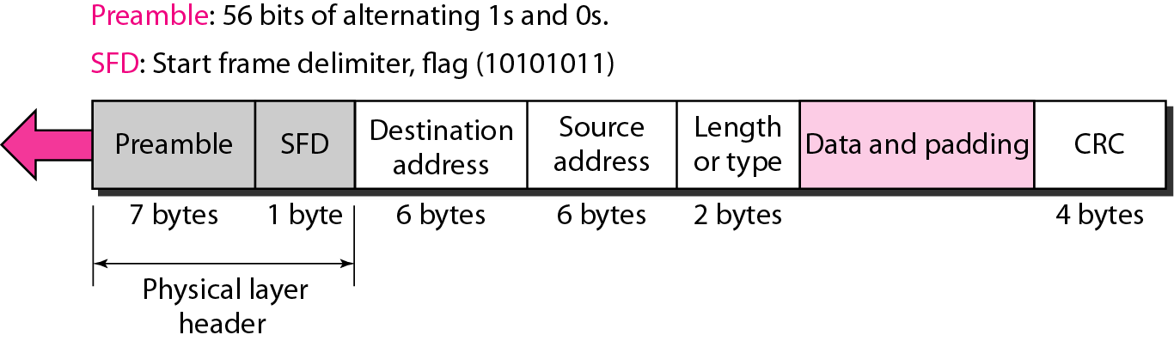
Figure 13.4 802.3 MAC frame

Slide 10
Ethernet Frame
Preamble:
8 bytes with pattern 10101010 used to synchronize receiver, sender clock rates.
In IEEE 802.3, eighth byte is start of frame (10101011)
Addresses: 6 bytes (explained latter)
Type (DIX)
Indicates the type of the Network layer protocol being carried in the payload (data) field, mostly IP but others may be supported such as IP (0800), Novell IPX (8137) and AppleTalk (809B), ARP (0806) )
Allow multiple network layer protocols to be supported on a single machine (multiplexing)
Its value starts at 0600h (=1536 in decimal)
Length (IEEE 802.3): number of bytes in the data field.
Maximum 1500 bytes (= 05DCh)
CRC: checked at receiver, if error is detected, the frame is discarded
CRC-32
Data: carries data encapsulated from the upper-layer protocols
Pad: Zeros are added to the data field to make the minimum data length = 46 bytes
FCS: Frame Check Sequence

Slide 11

Ethernet address
Six bytes = 48 bits
Flat address not hierarchical
Burned into the NIC ROM
First three bytes from left specify the vendor. Cisco 00-00-0C, 3Com 02-60-8C and the last 24 bit should be created uniquely by the company
Destination Address can be:
Unicast: second digit from left is even (one recipient)
Multicast: Second digit from left is odd (group of stations to receive the frame – conferencing applications)
Broadcast (ALL ones) (all stations receive the frame)
Source address is always Unicast

Slide 12
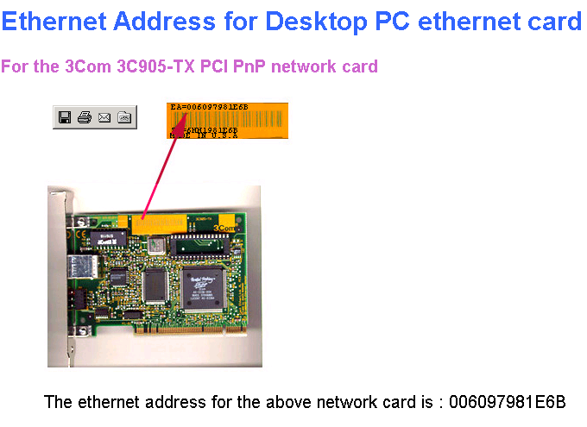

Slide 13

Note
The least significant bit of the first byte defines the type of address. If the bit is 0, the address is unicast; otherwise, it is multicast.

Slide 14
Note
The broadcast destination address is a special case of the multicast address in which all bits are 1s.

Slide 15
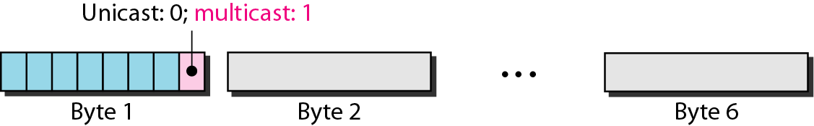
Figure 13.7 Unicast and multicast addresses

Slide 16
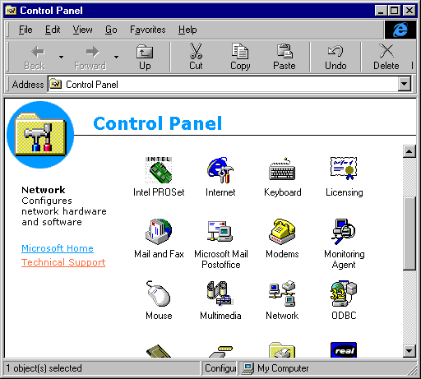
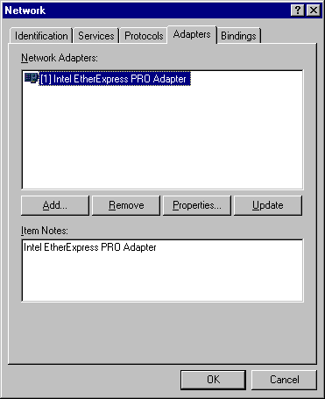
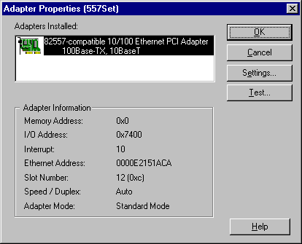
Ethernet Address
A physical address is the hardware-level address used by the Ethernet interface to communicate on the network. Every device must have a unique physical address
00 00 E2 15 1A CA

Slide 17
Example 13.2
Show how the address 47:20:1B:2E:08:EE is sent out on line.
Solution
The address is sent left-to-right, byte by byte; for each byte, it is sent right-to-left, bit by bit, as shown below:

Slide 18
Ethernet addresses are 48 bits long.
Ethernet addresses are governed by IEEE and are usually imprinted on Ethernet cards when the cards are manufactured.
Examples of Manufacturer IDs
Cisco : 00-00-0C- 3Com : 00-60-8C-
: 00-60-09- : 00-60-08-

Slide 19
Example 13.1
Define the type of the following destination addresses:
a. 4A:30:10:21:10:1A b. 47:20:1B:2E:08:EE
c. FF:FF:FF:FF:FF:FF
Solution
To find the type of the address, we need to look at the second hexadecimal digit from the left. If it is even, the address is unicast. If it is odd, the address is multicast. If all digits are F’s, the address is broadcast. Therefore, we have the following:
a. This is a unicast address because A in binary is 1010.
b. This is a multicast address because 7 in binary is 0111.
c. This is a broadcast address because all digits are F’s.

Slide 20
Note
Frame length:
Minimum: 64 bytes (512 bits) Maximum: 1518 bytes (12,144 bits)

Slide 21
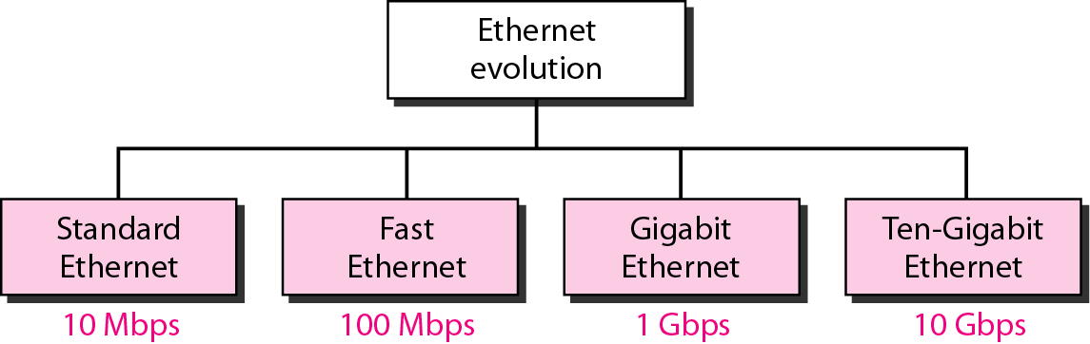
Figure 13.3 Ethernet evolution through four generations

Slide 22
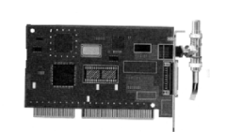
Baseband Transmission
Entire channel is used to transmit a single digital signal
Complete bandwidth of the cable is used by a single signal
The transmission distance is shorter
The electrical interference is lower
Broadband Transmission
Use analog signaling and a range of frequencies
Continuous signals flow in the form of waves
Support multiple analog transmission (channels)
Baseband Transmission
Modem
Broadband Transmission
Network Card

Slide 23
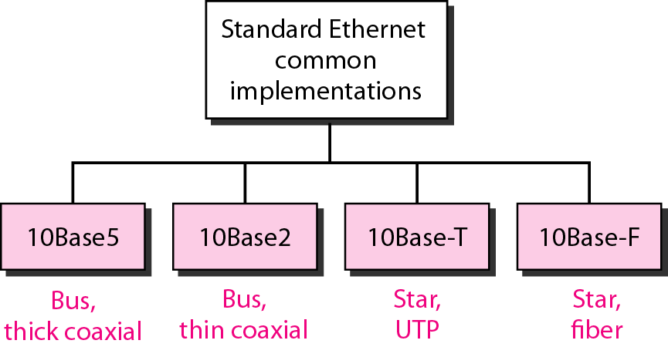

Categories of traditional Ethernet
<data rate><Signaling method><Max segment length or cable type>

Slide 24
IEEE 802.3 Cable Types
Name | Cable Max. | Max Cable Segment Length | Nodes /segment
10Base5 | thick coax | 500 meters | 100
10Base2 | thin coax | 185 meters | 30
10BaseT | twisted pair | 100 meters | 1
10BaseF | Fiber Optic | 2Km | 1
Toplogy
Bus
Bus
Star
Star

Slide 25
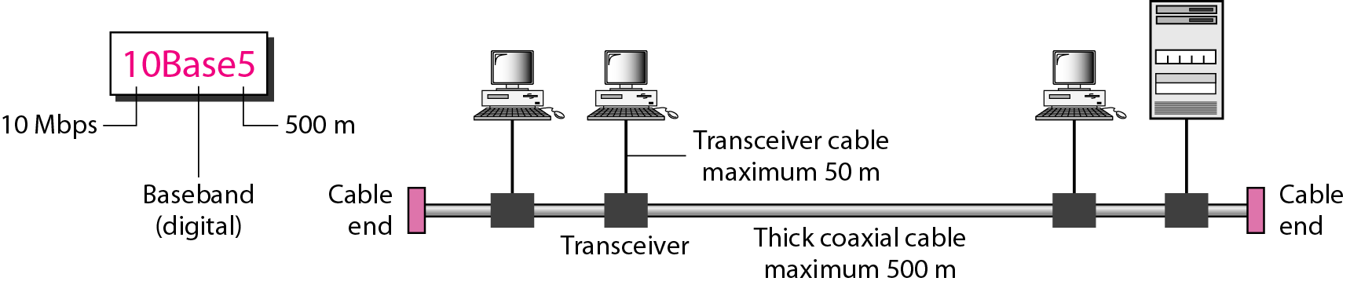
Figure 13.10 10Base5 implementation

Slide 26
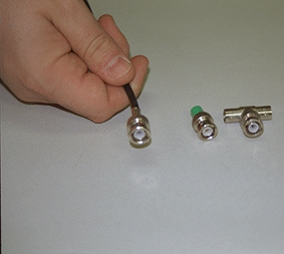
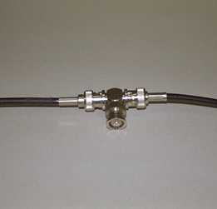
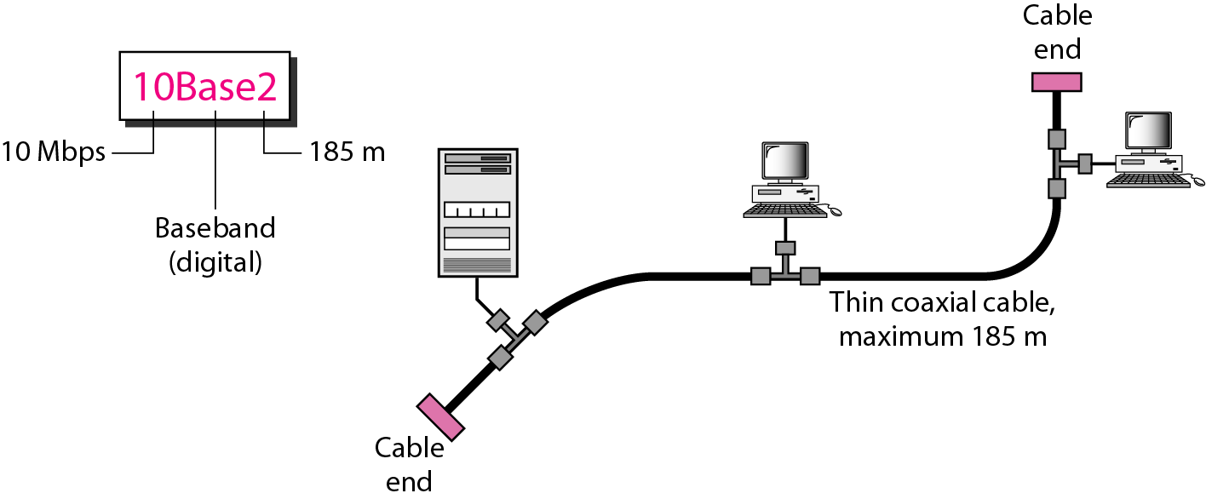
Connection of stations to the medium using 10Base2

Slide 27
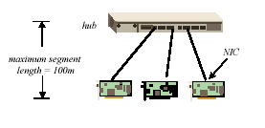
10BaseT
• Uses twisted pair Cat3 cable
Star-wire topology
• A hub functions as a repeater with additional functions
• Fewer cable problems, easier to troubleshoot than coax
• Cable length at most 100 meters

Slide 28
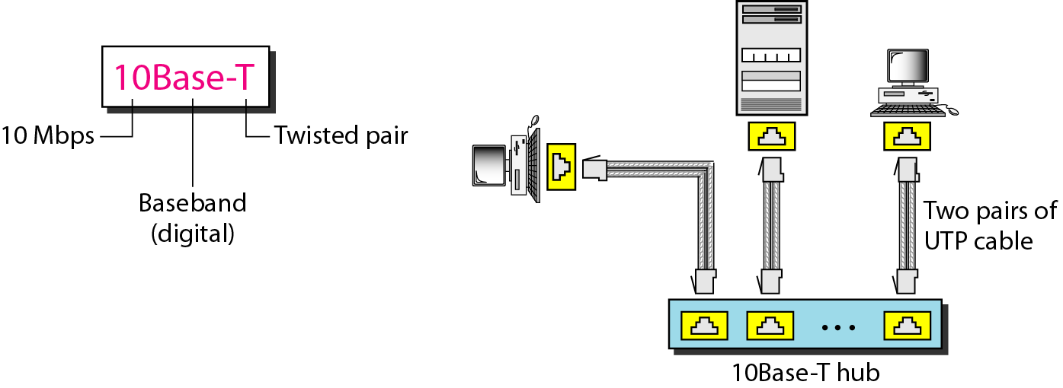
Figure 13.12 10Base-T implementation

Slide 29
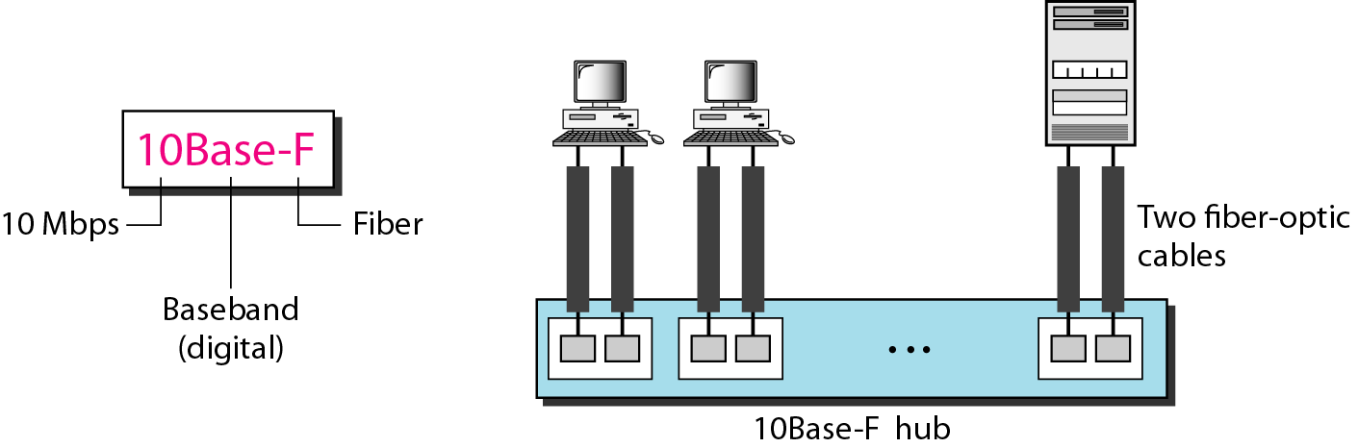
Figure 13.13 10Base-F implementation

Slide 30
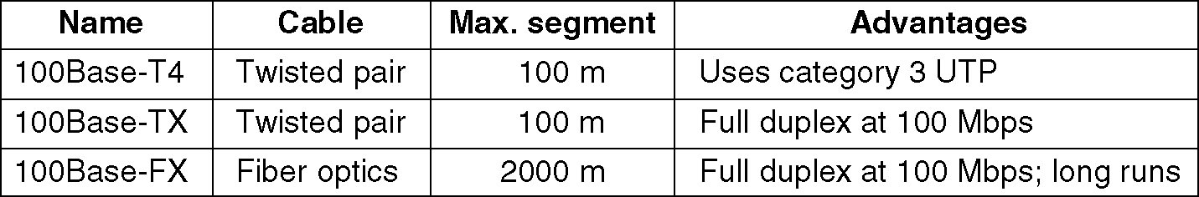
13.4 Fast Ethernet
100 Mbps transmission rate
same frame format, media access, and collision detection rules as 10 Mbps Ethernet
can combine 10 Mbps Ethernet and Fast Ethernet on same network using a switch
media: twisted pair (CAT 5) or fiber optic cable (no coax)
Star-wire topology
Similar to 10BASE-T
CAT 3
CAT 5

Slide 31
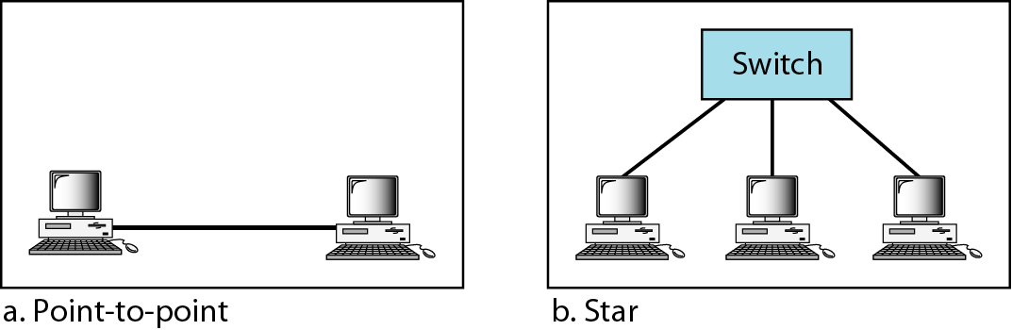
Figure 13.19 Fast Ethernet topology

Slide 32
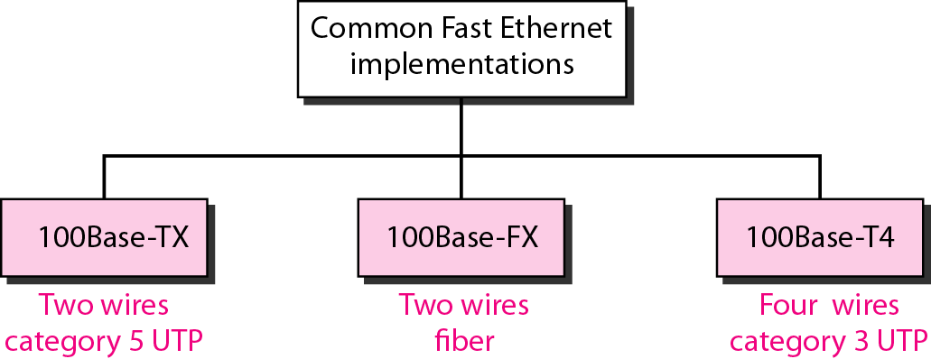
Figure 13.20 Fast Ethernet implementations

Slide 33
Full Duplex Operation
Traditional Ethernet is half duplex
Either transmit or receive but not both simultaneously
With full-duplex, station can transmit and receive data simultaneously
With full duplex, Throughput (actual transmission rate) is doubled.
10-Mbps Ethernet in full-duplex mode, theoretical transfer rate becomes 20 Mbps
100-Mbps Ethernet in full-duplex mode, theoretical transfer rate becomes 200 Mbps
Changes that should be made with any computer in order to operate in Full-Duplex Mode
Attached stations must have full-duplex NIC cards
Must use two pairs of wire one pair for transmitting from host to switch (inbound) and the other pair for transmitting from switch to host (outbound)
Must use a switch as a central device not a hub
Devices must be connected point-to-point (dedicated) to the switch
Each station constitutes separate collision domain
CSMA/CD algorithm no longer needed (no collision)
No limit on the segment length
Same 802.3 MAC frame format used

Slide 34
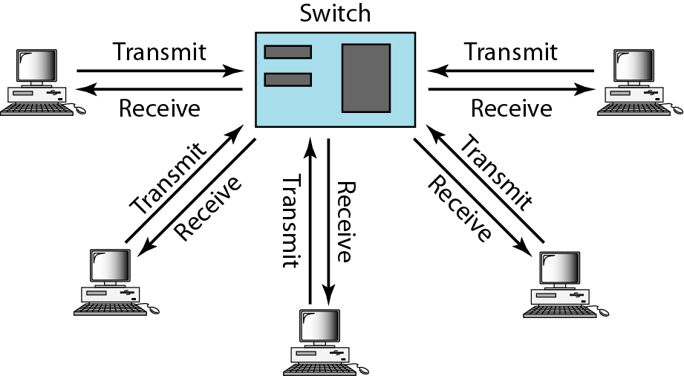
Figure 13.18 Full-duplex switched Ethernet

Slide 35
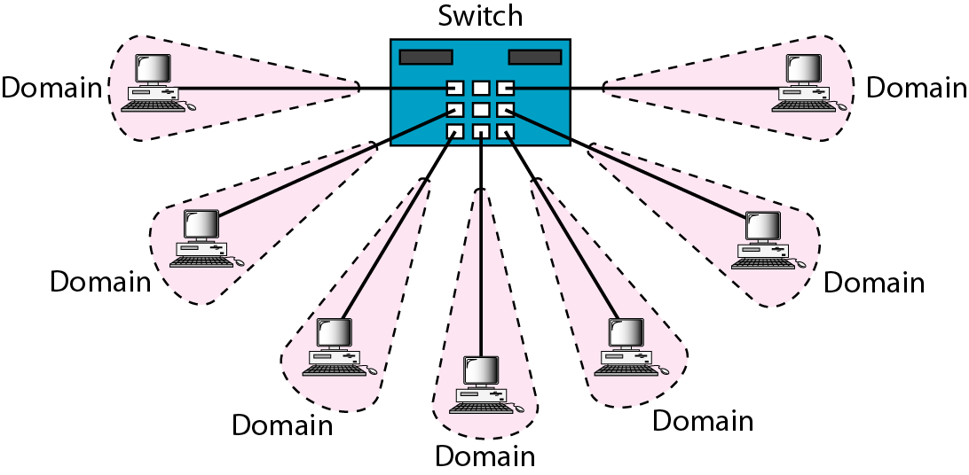
Figure 13.17 Switched Ethernet

Slide 36
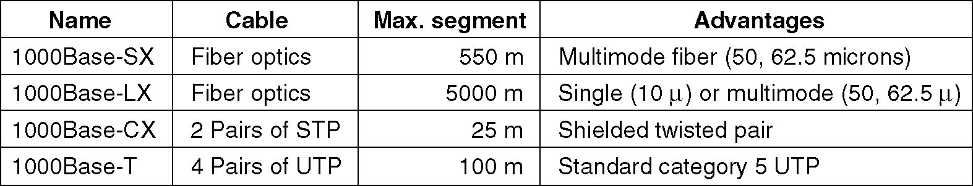
13.5 Gigabit Ethernet
Speed 1Gpbs
Minimum frame length is 512 bytes
Operates in full/half duplex modes mostly full duplex
Speed 1Gpbs
Minimum frame length is 512 bytes
Operates in full/half duplex modes mostly full duplex

Slide 37
Note
In the full-duplex mode of Gigabit Ethernet, there is no collision;
the maximum length of the cable is determined by the signal attenuation in the cable.

Slide 38
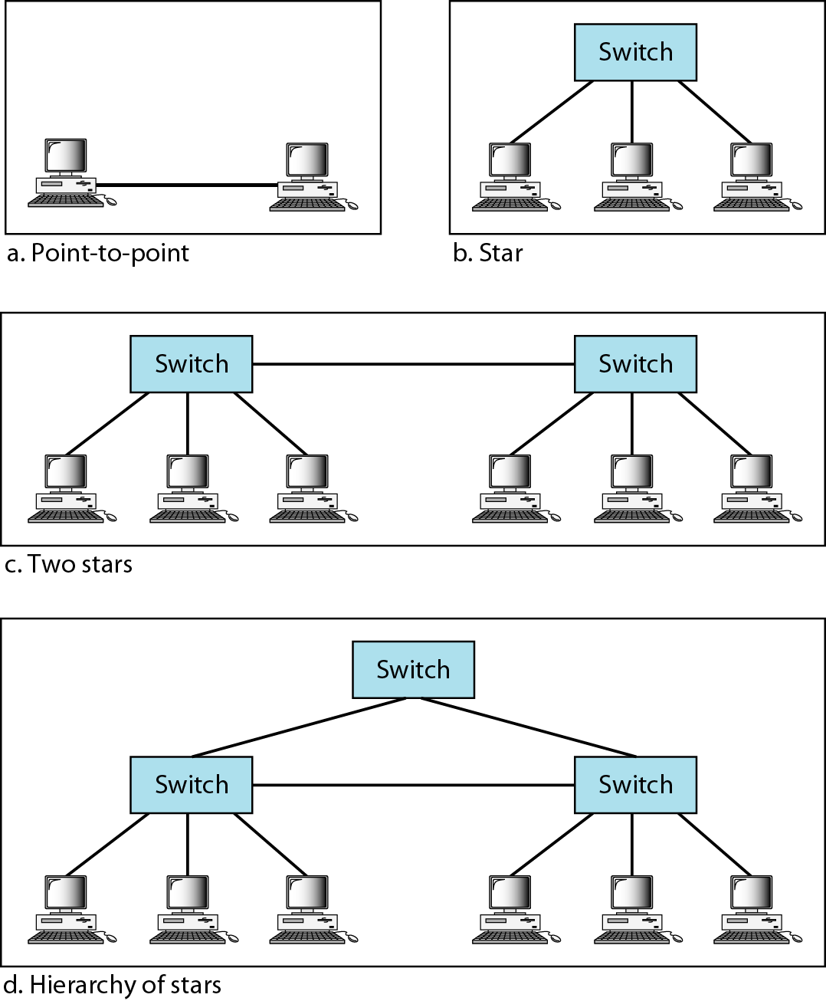
Figure 13.22 Topologies of Gigabit Ethernet

Slide 39
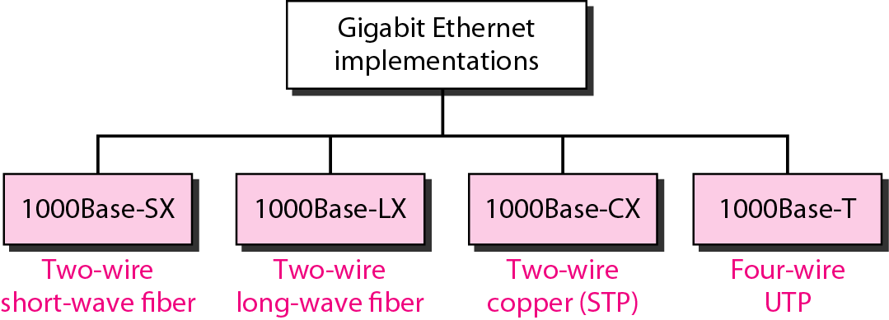
Figure 13.23 Gigabit Ethernet implementations

Slide 40
10Gbps Ethernet
Maximum link distances cover 300 m to 40 km
Full-duplex mode only
No CSMA/CD
Uses optical fiber only

Slide 41
Ethernet’s MAC Algorithm(Access Method - CSMA/CD )
In Aloha, decisions to transmit are made without paying attention to what other nodes might be doing
Ethernet uses CSMA/CD – listens to line before/during sending
If line is idle (no carrier sensed)
send packet immediately
upper bound message size of 1500 bytes
must wait 9.6us between back-to-back frames
If line is busy (carrier sensed)
wait until idle and transmit packet immediately
called 1-persistent sending
If collision detected
Stop sending and jam signal
Try again later

Slide 42
Collisions
Collisions are caused when two adaptors transmit at the same
time (adaptors sense collision based on voltage differences)
Both found line to be idle
Both had been waiting to for a busy line to become idle
A starts at
time 0
A
B
Message almost
there at time T when
B starts – collision!
A
B
How can we be sure A knows about the collision?

Slide 43
Collision Detection
How can A know that a collision has taken place?
There must be a mechanism to insure retransmission on collision
A’s message reaches B at time T
B’s message reaches A at time 2T
So, A must still be transmitting at 2T
IEEE 802.3 specifies max value of 2T to be 51.2us
This relates to maximum distance of 2500m between hosts
At 10Mbps it takes 0.1us to transmit one bit so 512 bits (64B) take 51.2us to send
So, Ethernet frames must be at least 64B long
14B header, 46B data, 4B CRC
Padding is used if data is less than 46B
Send jamming signal after collision is detected to insure all hosts see collision
48 bit signal

Slide 44
Collision Detection contd.
time = 0
A
B
A
B
time = T
A
B
time = 2T

Slide 45
Exponential Backoff
If a collision is detected, delay and try again
Delay time is selected using binary exponential backoff
1st time: choose K from {0,1} then delay = K * 51.2us
2nd time: choose K from {0,1,2,3} then
delay = K * 51.2us
nth time: delay = K x 51.2us, for K=0..2^{n} – 1
Note max value for k = 1023
give up after several tries (usually 16)
Report transmit error to host

Slide 46
Exponential Backoff
When a collision first occurs, send a “Jamming signal” to prevent further data being sent.
Resend a frame after either 0 seconds or 51.2μs, chosen at random.
If that fails, resend the frame after either 0s, 51.2μs, 102.4μs, or 153.6μs.
If that still doesn't work, resend the frame after k · 51.2μs, where k is a random integer between 0 and 2³ − 1.
In general, after the cth failed attempt, resend the frame after k · 51.2μs, where k is a random integer between 0 and 2^{c} − 1.

Slide 47
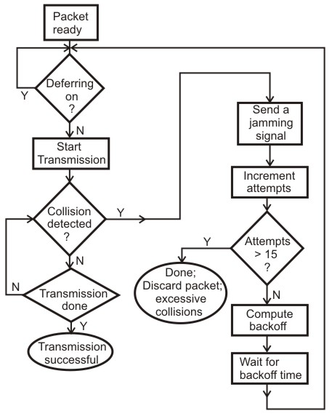
Exponential Backoff Algorithm used in CSMA/CD

Slide 48
MAC Algorithm from the Receiver Side
Senders handle all access control
Receivers simply read frames with acceptable address
Address to host
Address to broadcast
Address to multicast to which host belongs

Slide 49
CSMA/CD ― Design Considerations
More computers on the LAN, higher chance of collisions
Retransmission may result in collision again and cause further delay
As the result, the network becomes standstill
Hence, Ethernet is suitable for low traffic networks

